Slide 1
Team Name
Arav Gupta
Rahul Thakur
Sanshray Mittu

Slide 2
Case Study Understanding
Wiretel Telecom is facing high customer churn, impacting revenue and market positioning.
Churn rate: 18.4% (above industry average of 12%)
Customer data accuracy: Only 23%, making churn prediction unreliable
Revenue loss per 1% churn increase: ₹8 Cr
Silent churners: 80% of churned customers never complain
Major causes: Poor service quality, lack of impactful marketing, and ineffective loyalty programs

Slide 3
Problem Statement
Why is Wiretel experiencing higher churn despite customer service improvements?
Key Challenges:
Network issues remain unresolved (No major infrastructure improvements)
Loyalty programs don’t engage new customers
Advertisements fail to connect with Indian sentiments
High data inaccuracy weakens churn prediction models

Slide 4
Approach to Address the Problem
Assumptions Made:
Churn rate can be reduced by 14.5% with strategic interventions
Retailers & AI-driven behavioral analytics will improve data accuracy from 23% to 55%
Network investments must be prioritized for long-term retention impact
Root Cause Analysis (RCA) Framework Used:
Customer Cohort Analysis → Identified churn patterns across different user segments
Predictive Analytics with AI → Churn likelihood prediction using real-time behavioral triggers
Market Sentiment Analysis → Identified gaps in advertisement effectiveness
Do Mention : Assumptions made

Slide 5
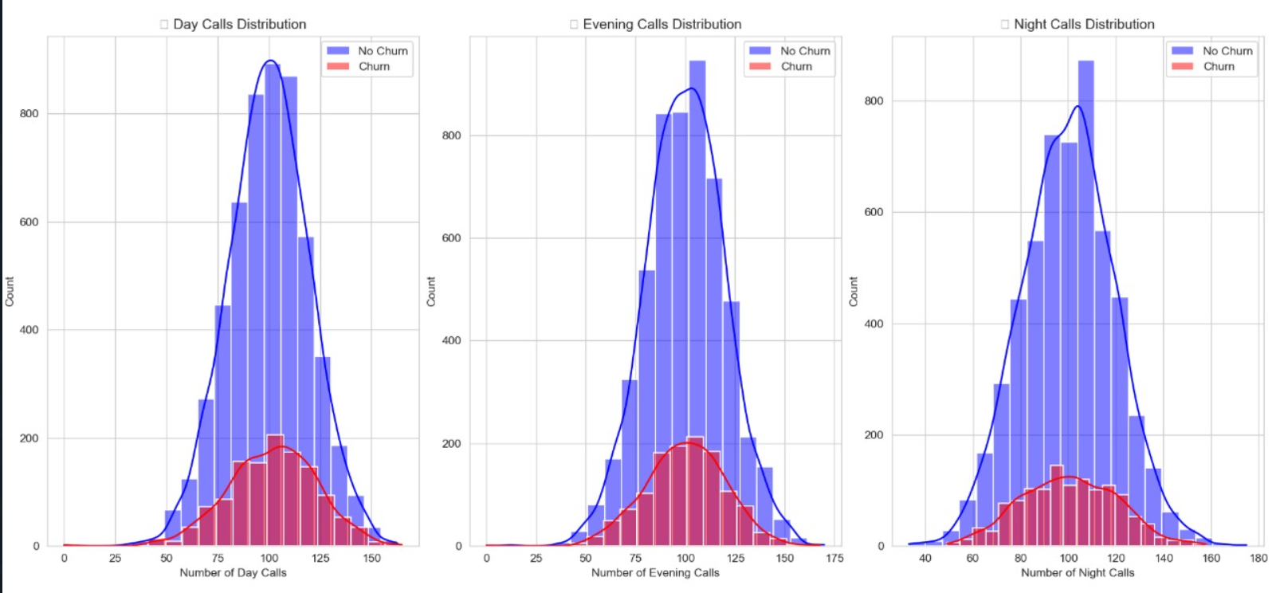
Solution Recommendation
A. Data-Driven Customer Retention Strategy
✅ Fix data accuracy issue:
Use AI to analyze real-time engagement data (e.g., data usage drop, call drop frequency).
Retailer data integration: Incentivize retailers to provide updated KYC data → Improve accuracy from 23% to 55%.
✅ Target Silent Churners Proactively:
Trigger re-engagement offers when usage patterns decline (e.g., no data usage for 5 days = SMS offer).
✅ Churn Prevention Impact:
Projected churn drop: 18.4% → 11.5%
Revenue retention impact: ₹8 Cr saved per 1% churn drop = ₹54.4 Cr net savings

Slide 6
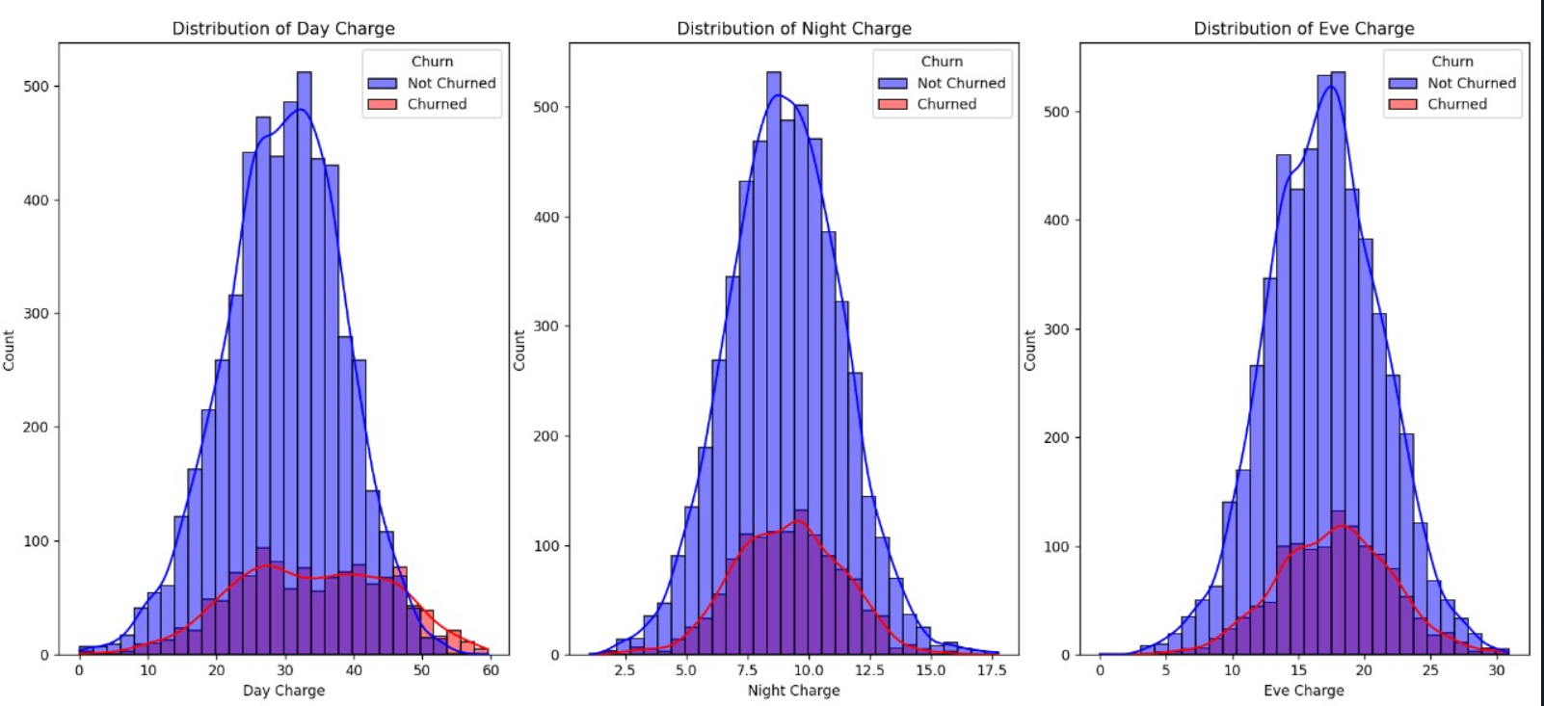
Solution Recommendation
B. Infrastructure Investments for Long-Term Churn Reduction
✅ Identify high-churn zones (geo-mapping churn hotspots) and prioritize network upgrades there.
✅ Deploy 4G network enhancements → Reduce dropped calls from 2.1% to <1.2%.
✅ Expected churn impact: 11.5% → 9.8% (long-term impact)
C. Marketing & Loyalty Program Reforms
✅ New Customer Loyalty Initiatives:
Engage new customers in the first 90 days with instant loyalty perks → Expected 3% churn drop in the new customer segment.
✅ Culturally Relevant Advertising:
Regional & sentiment-based campaigns → Higher emotional connect = 12% increase in ad engagement.
maximum peak or recharging is done in night or evening that means in the later half of the day we perform better

Slide 7
Parking Lot
Parking Lot (Unresolved or Future Considerations)
🔹 Need to explore alternative data enrichment methods (e.g., social media activity tracking). 🔹 Financial feasibility of long-term infrastructure upgrades. 🔹 Effectiveness of AI-based churn prevention in the Indian market (A/B testing needed).

Slide 8
Thank You
Team Name

